Slide 1
CIO Portfolio Update
Information Technology Association of Canada (ITAC)
June 18, 2013

Slide 2
Presentation Agenda
A Healthy Ontario – about Cancer Care Ontario
CIO Portfolio Operating Plan – Achievements and Highlights
CCO IT Procurement - Standards and Enterprise Architecture Blueprint
CIO DAY

Slide 3


A Healthy Ontario
Our Future Health | Built with Care

Slide 4


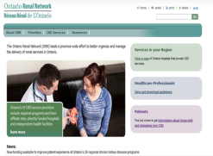
Cancer Care Ontario – About Us
  A provincial government agency which directs and oversees more than $1 billion to hospitals and other cancer care providers to deliver high quality, timely cancer, kidney and other healthcare services
  Uses information technology/management, informatics, project management and clinical expertise to execute provincial strategies
Cancer
CCO’s core mandate since 1943 as mandated by the provincial Cancer Act
Access to Care
Building on Ontario’s
Wait Times Strategy
Chronic Kidney Disease Ontario Renal Network launched June 2009

Slide 5
CCO’s Evolution
Cancer Act passed;
Ontario Cancer
Treatment Research Foundation (OCTRF) born
Ontario
Breast Cancer Screening Program launched
Cancer Quality Council of Ontario created to measure system performance
Ontario
Renal Network created
Cancer
Care Ontario
Specialized Cancer Services
1940
1990
2002
2009
THE EVOLUTION
Today
Ontario
Cancer Registry transferred
to OCTRF
CCO launches under new name to promote better integration of cancer services
CCO implements Wait Times Information System public reporting of wait times
Specialized cancer services
(i.e., Bone Marrow Transplant)
Access to Care
1970
1997
2004/5
2010
Ontario Renal Network

Slide 6
CCO Organizational Chart
Human Resources
President & CEO
Board of Directors
Chief Financial Officer
Corporate Services, General Counsel & Chief Privacy Officer
Ontario Renal Network (ORN)
Planning & Regional Programs
Clinical Programs & Quality Initiatives
Chief Information Officer
Prevention and Cancer Control
Communications

Slide 7
Our Core Competencies
Mandated Service
Core Competencies
Performance Management and Management Cycle
Cancer
As mandated by the Cancer Act; Ontario Cancer Plan III
Access to Care
Building on Ontario’s Wait Time Strategy
Chronic Kidney Disease
Ontario Renal Network launched June 2009
Health System
Policy Expertise
Driving performance and quality
Standards
and Guidelines
Public Reporting
and Transparency
Clinical Engagement and Alignment Regional Partnerships
IM/IT
Notes:
CCO has the Foundation and Competencies to Support our Business lines

Slide 8

CIO Portfolio Operating Plan
2012-2013 Achievements
2013-2014 Highlights

Slide 9

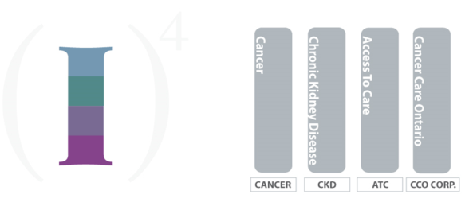
CCO Information Strategy 2011-2015
Innovation
Informatics
Instrument
Infrastructure

Slide 10


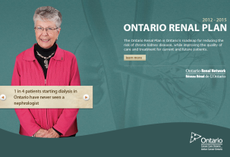



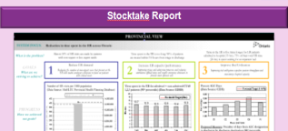
CIO Portfolio
Business
Workflow
STRATEGY
Annual Reporting Against 4 yr Goals
PLAN
ANNUAL OPERATIONAL PLAN
Annual Reporting
SET PERFORMANCE OBJECTIVES
BUSINESS OPERATIONS
EXECUTE
Bus. Dev.
PMLC
Gating
Finance
HR
Privacy
Procurement
Tech Services
ARB
Performance
Reporting
MEASURE
Notes:
This is our overarching process – our business work flow
Our initiatives over the year will deepen and strengthen this process

Slide 11
CIO Planning Cycle Overview
Technology Vendors engaged in the development.
Shared Priorities
3 Year Projection of CCO Priorities
CCO Business Planning
Strategic Requirements
CEC Retreat
CIO Operating Plan Deliverables
CIO OP Deliverables Embedded
Business Partner Day
CIO Leadership Retreat
PDP
2012-13
2013-14
CIO OP Launched
Corporate Driven
CIO Operating Plan
Notes:
Existing and future technology selected as standard will take these into consideration

Slide 12
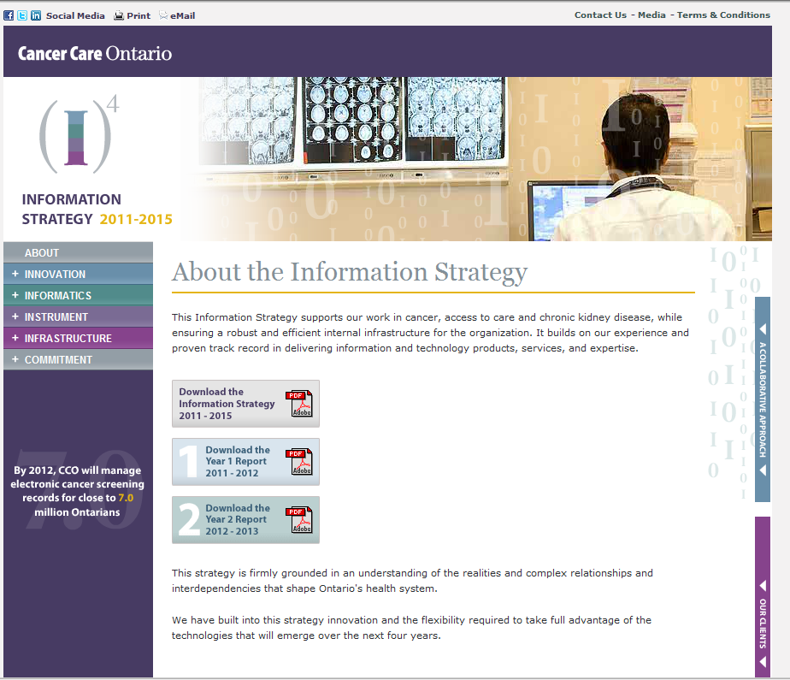
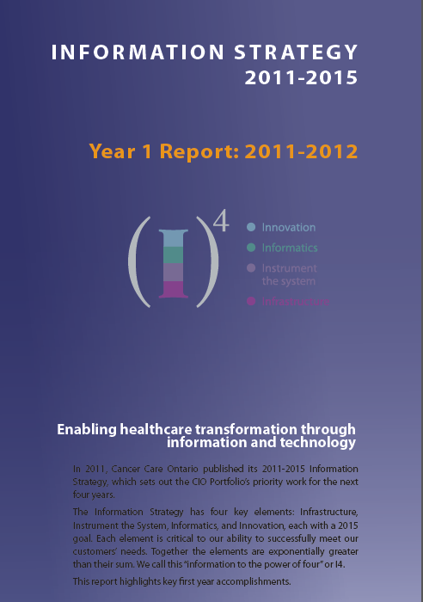
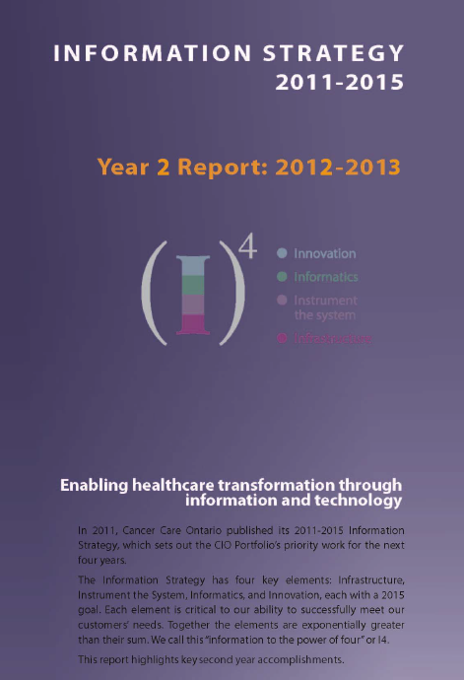
Our Successes: Year 1 and Year 2
Notes:
Existing and future technology selected as standard will take these into consideration

Slide 13
Achievements in 2012-2013

Slide 14

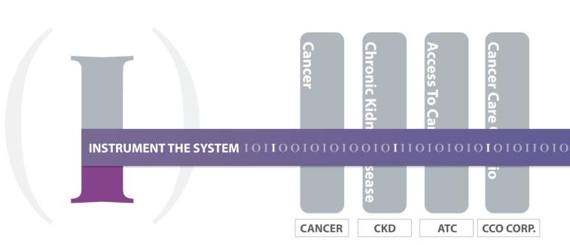

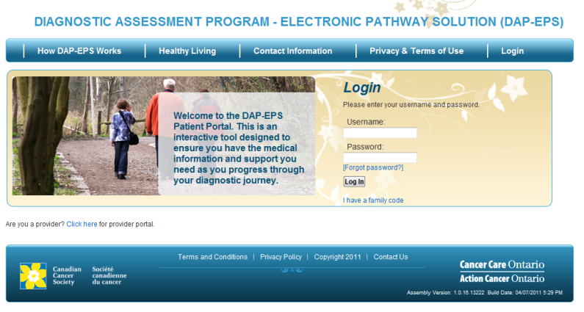
The tools and systems to capture and deliver data
Apply comprehensive, integrated information and technology solutions across the patient journey.
Cancer Information Program
100% used by physicians where implemented
Systemic Treatment (chemotherapy) solutions for Ontario’s cancer treating hospitals:
Completed the implementation of OPIS, CCO’s ST CPOE system, to an additional 19 hospitals
Commenced Oncology Information Systems standards (technical, clinical and integration data)
Developed and launched CCO eClaims
Diagnosis solution:
Expanded DAP-EPS to more regions, enabling patients/providers in the diagnosis phase to access information on diagnostic tests/ examinations
Notes:
OPIS – still the most widely used ST CPOE on ON and together with other similar systems enhances the delivery of chemotherapy
thereby increasing proportion of Ontario chemotherapy visits supported by to over 90%
ST CPOE BPG to help inform and guide continuous improvement of ST CPOE systems based on best available evidence
eClaims - to streamline and automate adjudication of chemotherapy claims from hospitals for new drugs totaling over $200M annually
Drug Formulary - Provided direct access links from ST CPOE systems to CCO’s web based drug formulary
OPIS is still the most widely used ST CPOE in Ontario and, together with other similar system,…” and then “In short ST CPOE improves…”

Slide 15

The tools and systems to capture and deliver data
Apply comprehensive, integrated information and technology solutions across the patient journey.
Cancer Information Program cont’d
Implemented standardized pathology reports used in 97% of ON’s hospitals
Reached over 90% population based stage capture for the four most common disease sites (breast, colon, prostate and lung)
Redesigned ISAAC to enable hospitals to collect many patient reported outcome measures and created an iPad version
Point of Care technologies:
Web based and mobile app Drug Formulary at point of care for providers (mobile app for patients)
eOutcomes iPad tool for physicians to collect data on head & neck cancers
Notes:
Implemented standardized pathology reports used in 97% of ON’s hospitals ensuring cancer patients get the same high-quality pathology reporting, no matter where they live
Redesigned ISAAC to enable hospitals to collect many patient reported outcome measures and created an iPad version used in addition to ISAAC kiosks currently located at all cancer centres and many community hospitals in Ontario
Web based and mobile app - Drug Formulary - provides vital chemotherapy drug information at point of care for providers (mobile app for patients)

Slide 16

The tools and systems to capture and deliver data
Apply comprehensive, integrated information and technology solutions across the patient journey.
Ontario Renal Network (ORN)
Ontario Renal Reporting System (ORRS) - Release 2, Implemented
ORRS Expose with upload, development and testing near completion
New ORRS reports based on the Patient Based Funding Business Requirements Document
Initiated work to define the current ORN Information Management / Information Technology (IM/IT) Strategy
Completed preparation to link the Ontario Laboratory Information System (OLIS) data to ORN reporting and analytics

Slide 17
The tools and systems to capture and deliver data
Apply comprehensive, integrated information and technology solutions across the patient journey.
Access to Care (ATC)
Deployed four new Alternate Level of Care (ALC) data elements to 121 facilities
Deployed the Wait Time Information System (WTIS) to 10 new facilities
Collection and reporting of Wait 1 data initiated
Began manual reporting of DI wait times at seven Independent Health Facilities (IHFs)
Achieved 99% + availability of the Cardiac Care Network WTIS Application

Slide 18
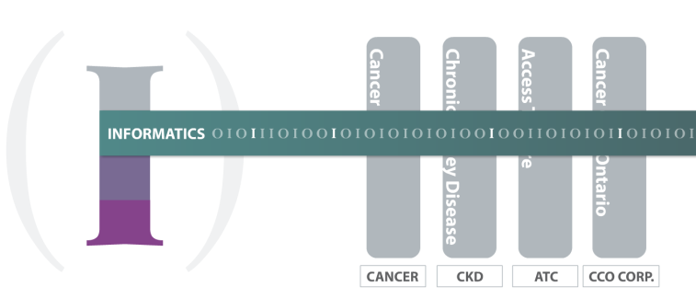
The art and science of transforming data into actionable information
Provide actionable information to decision-makers to improve performance management.
Informatics
Developed enterprise models and frameworks to support the expansion and management of CCO’s data holdings
Established Enterprise Data Reference Architecture and Metadata Management Models
Developed plan to reach future state of Business Intelligence over the next three years
Established Expert Advisory Panel with external partners to foster/support collaboration with CCO
Implemented Customer Management Plans Improved operational efficiency
Implemented initiatives to automate process and reports, and integrate data holdings including OHIP
Notes:
Developed enterprise models and frameworks for Data Governance, Data Acquisition, Data Quality and Data Sharing Agreements to support the expansion and management of CCO’s data holdings
Established Enterprise Data Reference Architecture and Metadata Management Models
Envisioned future state of Business Intelligence and developed a plan to get there over the next three years
Established an Expert Advisory Panel with external partners fosters collaboration between CCO and thought leaders within the Ontario healthcare system
Implemented Customer Management Plans Improved operational efficiency
Implemented numerous initiatives to automate process and reports, and integrate data holdings including OHIP

Slide 19
The tools and systems to capture and deliver data
Apply comprehensive, integrated information and technology solutions across the patient journey.
Prevention & Cancer Control Information Program
Published the new ColonCancerCheck (CCC) Screening Activity Report (SAR)
Implemented eReport (securely delivers PHI level reports online) integrated with eHealth Ontario’s ONE ID service
Generated the first Screening Activity Report (SAR) for the First Nations community of Sandy Lake
Developed an on-line Cancer Risk Assessment prototype for Ontarians
InScreen utility/resource
Notes:
Published the new ColonCancerCheck (CCC) Screening Activity Report (SAR) to provide important colorectal cancer screening information for over 7,500 Primary Care Physicians
Implemented eReport, a platform for securely delivering PHI level reports online, integrated with eHealth Ontario’s ONE ID service
Generated the first Screening Activity Report (SAR) for the First Nations community of Sandy Lake
Developed an on-line Cancer Risk Assessment prototype for Ontarians
InScreen resource – see diagram following this slide

Slide 20
InScreen™ overview
  Key Benefits:
      increases awareness
      initiates contact
      supports population-based cancer screening
      provides view of screening journey
      informs practices
Screening Functionality
Identify
Invite
Notify
Recall
Remind
Report
Creating and Managing Screening Records
Reporting and Business Rules Maintenance
Siebel Marketing and Campaign Management
OBIEE – Oracle Business Intelligence
BI Tools
Reporting and Analytics
Data Collection and Integration
Screening Data Warehouse
Data Hub
Data Sources
Hospitals
Labs
Ministry
CCO
Notes:
Almost 8,000,000 electronic screening records for eligible Ontarians; 200,000 updates per month
Almost 250,000 screening results received per month for all 3 programs
Data is provided by 10 different sources throughout the province
1,200,000 pieces of correspondence generated for CCC in 12/13. Forecast is 6,800,000 for all 3
Campaign Management has reduced the time to generate a campaign from 4+ months to weeks
130,000,000 claims records supporting the 3 screening Programs
Generates 21,000 reports for 7,500 Family Physicians – in less than a day
Reports are provided securely on-line to Physicians registered with ONEID
Adding the additional 2 Program has reduced the operational cost of processing a screening result from approx $7 per result to approx $3 - $4 per result

Slide 21
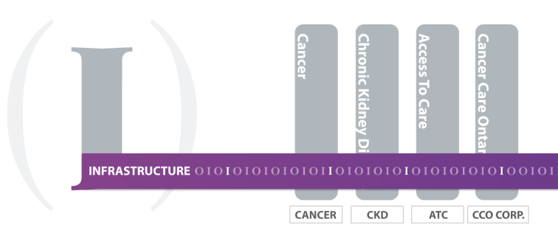
The right people, process and technology
Create a robust foundation for the delivery of information and technology products and services and actionable information.
Enterprise Services Information Program / Shared Services
Established the Enterprise Services Information Program (ESIP) to be accountable for corporate wide technology tool development, delivery and ongoing support of those tools
Developed a CIO Business Analyst Competency Model and Community of Practice
Established a Project Management Community of Practice
Enhanced CCO’s PPM Tool and launched the PPM Mobile Application
Enhanced the CIO Portfolio Scorecard to enable informed decision-making and continuous improvement

Slide 22
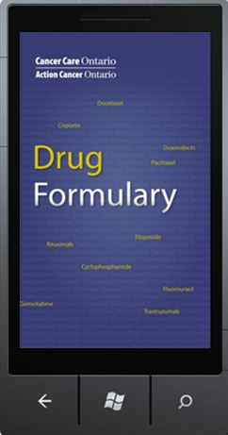


The right people, process and technology
Create a robust foundation for the delivery of information and technology products and services and actionable information.
Tech Services
Launched CCO’s Enterprise Architecture Blueprint to provide a framework for managing CCO‘s IT assets, operations, projects and people with operational and strategy
Completed the building of CCO’s Enterprise Architectural (EA) and governance structure
Developed, published and implemented a Technology Services Roadmap
Published 3 mobile applications (Head & Neck, Drug Formulary and Corporate Toolkit)
Executed a Data Centre Transition Plan – to a co-lo provider

Slide 23
Highlights for 2013-2014

Slide 24
The tools and systems to capture and deliver data
Apply comprehensive, integrated information and technology solutions across the patient journey.
Cancer Information Program
Develop a knowledge tool on available genetic testing in Ontario for providers & patients
Develop and deploy solution to transmit patient level data on specialized services (i.e., stem cell transplants, sarcoma, acute leukemia) from hospitals to CCO

Slide 25
The tools and systems to capture and deliver data
Apply comprehensive, integrated information and technology solutions across the patient journey.
Ontario Renal Network (ORN)
Build and support an operational model for eLab data management for the ORN
Develop, deploy and operate ORRS Expose
Identify new additional data elements in ORRS to align to funding model and to improve performance reporting and analytics from ORRS data
Develop an Information Management / Information Technology (IM/IT) Strategy for the ORN

Slide 26
The tools and systems to capture and deliver data
Apply comprehensive, integrated information and technology solutions across the patient journey.
Access to Care (ATC)
Deploy the Wait Time Information System (WTIS) to remaining facilities in Ontario which currently perform surgical or diagnostic imaging (DI) procedures
Deploy the WTIS to seven DI IHFs
Launch Surgeon Scorecard Pilot
Transition MRI efficiency activities from University Health Network to ATC. Release first reports to participating sites in November 2013.

Slide 27
The art and science of transforming data into actionable information
Provide actionable information to decision-makers to improve performance management.
Informatics
Implement an Enterprise standard tool for uploading inbound data
Implement an indicator catalogue and expand associated meta data content
Implement new de-identification tool & Policy
Design & implement Business Intelligence (BI) Intake & Prioritization Process
Move the new Ontario Cancer Registry (OCR) to production and retire the Ontario Cancer Registry Information System (OCRIS)
Implement SAS Data Management/Data Quality

Slide 28
The tools and systems to capture and deliver data
Apply comprehensive, integrated information and technology solutions across the patient journey.
Prevention & Cancer Control Information Program
Finalize requirements and design for the production version of the On-line Cancer Risk Assessment Tool for 3 cancers
Generate a multi-program Physician Screening Activity Report for colorectal, breast and cervical cancer screening and distribute on-line using eReports
Implement and deploy a solution to acquire and integrate screening data from Breast Screening sites not currently participating in the Ontario Breast Screening Program
Implement invitation campaigns for colorectal, cervical and breast screening to increase screening rates
Implement new access/distribution channels for Ontarians to obtain a screening test kit
Integrate the results of the new Fecal Immunochemical Testing (FIT) pilot into InScreen & plan for implementation in 14/15
Implement mobile and web based solutions for presenting breast and colorectal screening guidelines to Physicians

Slide 29
The right people, process and technology
Create a robust foundation for the delivery of information and technology products and services and actionable information.
Enterprise Services Information Program / Shared Services
Productive use of Customer Relationship Management (CRM)
Deployment of eProcurement Tool
Increase Project Management (PM) Centre of Practice
Review and streamline CIO Portfolio’s reporting processes

Slide 30
The right people, process and technology
Create a robust foundation for the delivery of information and technology products and services and actionable information.
Tech Services
Create BYOCD (Bring Your Own Computing Device) Plan
Continue to modernize CCO’s office productivity
Plan and release deployment activities to update current and standardize versions of all enterprise systems
Design a multi-year Data Centre Strategy to support CIO’s Business Continuity Plan
Implement mobile and web-based screening tools and guidelines

Slide 31
CCO IT Procurement – Standards
Enterprise Architecture Blueprint

Slide 32
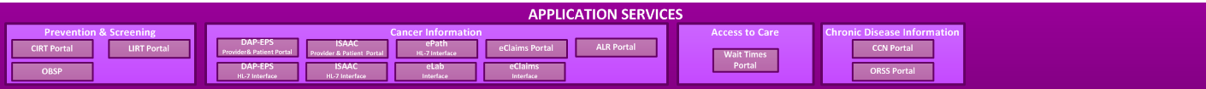
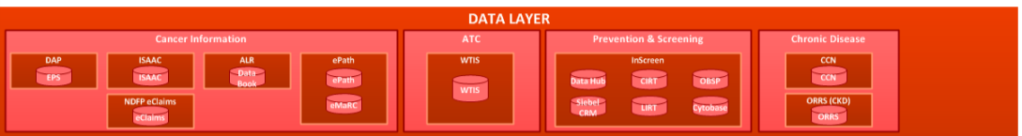
Future state
  All supported by wholly integrated systems and services

Slide 33


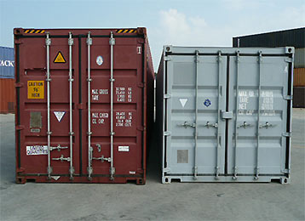

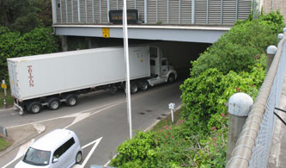
Why have Standards?

Slide 34
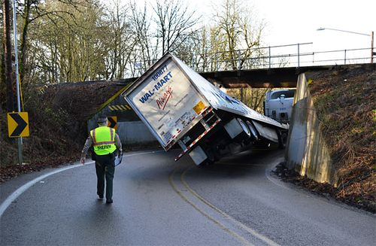
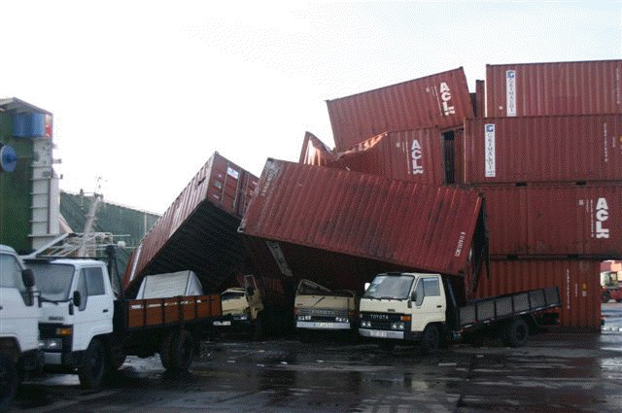
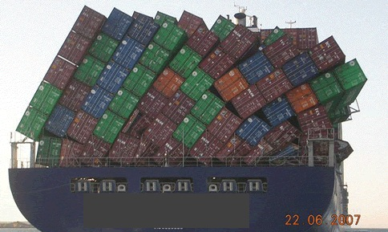
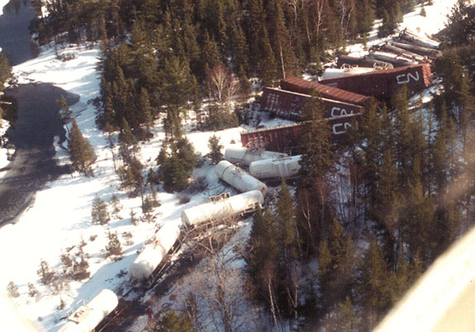
What happens without standards?

Slide 35
Principles of Architecture /
IT Procurement
1
2
3
CCO determines its architecture.
Vendors provide solutions that meet CCO architecture with the best quality services and at the best price.
CCO will leverage all possible value from solutions that support its architecture.
4
5
6
CCO’s architecture is supported by CCO’s procurement policies.
No competition between technology stacks or supplementary solutions.
CCO publicizes its architecture and supporting technology stacks.

Slide 36
Considerations of Architecture /
IT Procurement
Technology selected as standard, considers various factors:
1
2
3
Technology impact and solutions already used by CCO
Full life cycle cost of solutions that take into account people, process and technology
Human resources impact including current skills and capabilities

Slide 37


Core IT Infrastructure Standard:
Core Technology Stacks
    Desktop Technologies
    Enterprise Service Technologies
    Back-end Service Technologies
    Campaign Management
    Web Presentation
    Database Solutions
Notes:
These stacks are supported by Third Party Tools or “Supplementary” software solutions

Slide 38
Single Vendor Example - Dell
Single Infrastructure
Vendor
End User Computing
Server
Storage
Network
Leasing
Support & Account Management
Notes:
Is this purchasing or VOR
By setting our standard technology we are able to partner with a single vendor to provide services

Slide 39
Multiple Vendors Provide Resources: Preferred Vendor Program
A New Way For CCO To Do Business
Awarded – late 2011 for 3 years
Provides project and task based services
4 vendors on the program:
  Affinity
  Dapasoft
  Accenture
  HP
Notes:
Because we standardized our tech environment, multiple vendors are able to provide resources for short term contracts efficiently and effectively
PVP – preferred vendor project

Slide 40
How Does Preferred Vendor Program Work for Projects?
Project Awarded
CCO develops conceptual and logical architectures
CCO .NET team and PVP vendors hold detailed “Technical Discussion”
RFS is released
Approach and architectures updated
1
2
3
4
Notes:
What is ‘it’?
PVP – short term and long term

Slide 41
How Does it Work for Tasks?
Resource Provided
CCO identifies skill needs
Request sent to NEXT vendor on the list
Resource allocated & roster updated
Vendor fulfills or passes along to next vendor
1
2
3
4

Slide 42
Key Benefits
Projects
Engaged Vendors and CCO staff
More informed RFS process with clearer understanding
Tasks
No sorting through resumes, no interviews – great skill levels
Roster ensures all vendors get access to all rostered CCO .NET opportunities

Slide 43
What is this about?
5 Projects Awarded
Approx. $5 M in project services
4,000+ Days of Task Based Services
Approx. $ 3.5m in Task Based Services
Summary to Date
1
2
3
4

Slide 44
Enterprise Architectural Blueprint
http://cancercare.on.ca/about/architecture/

Slide 45
Insert Highlights Video
Notes:
CLICK VIDEO WITH MOUSE TO PLAY

Slide 46
2014 SPONSORSHIP
http://www.cioday.ca

