Slide 1
QuadGen Wireless Solutions, Inc. A Partner You Can Trust For Next Generation Network Services
Smart Cities for India
Dr. C S RAO

Slide 2
Smart City Vision
“ To Conceptualize ,architect and Implement Always on Connected City , for e – Gov., G2C services for citizens , Digitally monitorable city for Energy management, i.e. Smart Grid city, Traffic Monitoring, LED street Lights , Waste Management, Water Supply Monitoring , through Urban Web of Interconnected systems with a Digital Smart City Control Room ”

Slide 3
Smart City Mission
“ To engage Canadian Industry leaders in a consortium from an Interdisciplinary Digital Computing, Communications ,Control and Command Systems to evolve and unveil a pragmatic technologically implementable phased plan in next 90 days with Smart City Integrated solution Verticals with support from Canadian Industry & Thought Leaders etc. at Optimal Costs and offer perceptible, impactful and result oriented solution in 30 months time.”
Target and aim to Emulate, and Evolve Smart cities like E.g. Barcelona, Spain, Canada’s Edmonton, Vancouver, Toronto, Montreal, Ottawa etc. , and APAC models from Singapore, Fort Lauderdale, USA , Guadalajara in Mexico etc.

Slide 4
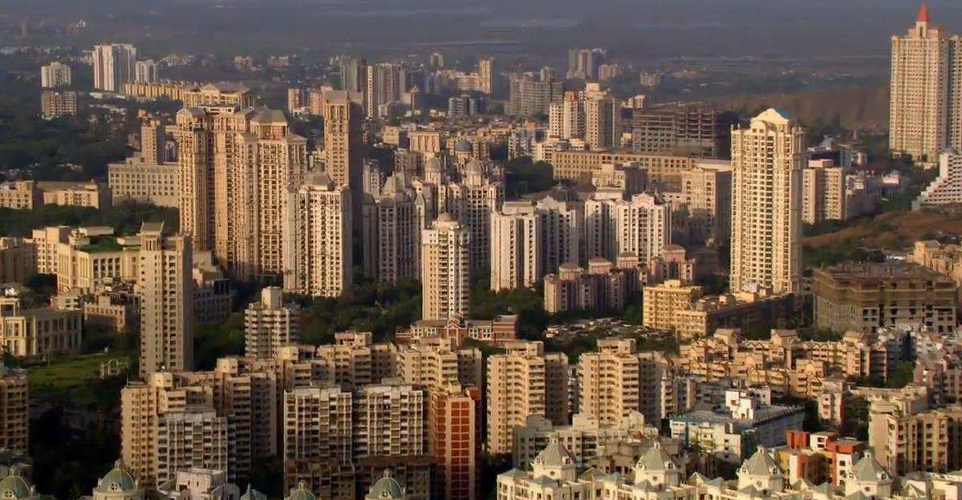
Context –SMART Cities
Much of the expected urban growth will take place in countries of developing regions, namely Asia and Africa. In India also, it is recognized by the Gov.
2014 revision of the World Urbanization Prospects by UN DESA’s Population Division notes that the largest urban growth will take place in India, China and Nigeria.
India has the largest rural population of 857 million.
By 2050, India is projected to add 404 million urban dwellers and by 2020 about 250 Million Population .
Properly managing urban settlements will be one of India’s key development challenges of the 21st century
The BJP-led Government has allocated Rs.7,060 crore in the Union Budget 2014 for developing 100 smart cities all over India.

Slide 5
Focus of Today’s Smart Cities Objective
Strategies to innovate to maintain service levels, in the following domains of ….
Energy Mgmt., Water Supply Mgmt. & Sewage Treatment Plants
Connected City on 4G and Wi-Fi for Schools, Colleges and Public places
Traffic Congestion Management & GPS Navigation
Weather Forecasting sensor NW
Video Surveillance for Security & Healthcare service dissemination
Online Kiosks for City Information for Tourists
Metropolitan Transport on High Speed Railways with Connectivity
G2C services dissemination & G2E communications .
Law & Order enablement thru online Crime Database
Responsive “100” System with Tracking on GPS
Finance ,Technology, Eng. and Planners of the Smart City Project is critical in the domains of Telecom, IT, Instrumentation and Software .

Slide 6
End Goal of Smart City Impact

Slide 7
Smart City : A Technology Perspective
Smart City approach is a pragmatic, engineering-based attempt to improve the operation of multiple facets of urban infrastructure and services with technology-based innovation in the planning, development, and operation of cities with the 4 Pillars of Mobile, Cloud ,Internet and IT
“Smart City makes use of integrated Hardware, Software ,Control, Instrumentation and Network technologies to make its critical infrastructure components and services (such as city administration, education, healthcare, public safety, real estate, transportation, and utilities) more intelligent, interconnected, and efficient in order to improve sustainability and livability.
Recent technological advancements allow municipal governments to coordinate the operations of their multiple agencies in the same way that medium and large-scale commercial enterprises operate.

Slide 8
Smart City Architecture

Slide 9
Smart City – Prime Services Target
Smart City associated products and services are :
Intelligent transport systems: Traffic monitoring and management, congestion management, road user charging, emergency response, public information systems, smart parking, and integrated traffic light management;
Assisted or Independent Living: Tele health and Tele care products and systems, and digital participation services;
Water Management: Water system upgrades, consumption monitoring, wastewater treatment, environmental safety systems, and flood management;
Smart grids or energy networks: Demand management, electronic vehicle support, energy efficiency program, and renewable energy integration; and
Waste management: Waste collection modelling and consistent supply to energy generation.

Slide 10
Types of Smart City Development models
5 types of organizations that must work together to build a Smart City:
public organization, where the State or the municipality has an entire project’s responsibility;
public-private-partnerships, where the State assigns parts of a project to private companies;
State-owned-enterprise where a new organization is grounded to supervise a project, with the participation of the State and the private sector;
private companies that implement a project;

Slide 11
Smart City Scope of Work
Smart City implementation should adopt a bottom-up approach focusing on :
Network Infrastructure (OFC) and Broadband NW
Traffic mgmt., Video Surveillance , Energy mgmt., related Content and Apps
Building intelligence (utilities that enhance local intelligence, i.e., wireless sensors)
E - Services Delivery Platform (SDP) to citizens
Adopting inter-operable standards to facilitate systems integration for future proof , migration, multivendor approach, global standards based and highly Mission critical Availability, Reliability and Maintainability standards.
Telco's, IT Majors, Software Majors and Cable Companies need to be the stake holders with Electricity, Water, Transport, Health, Police, and Education departments as prime stake holders led by Urban Development Ministry .

Slide 12
Identified Barriers to adoption of Smart Cities
Smart Cities are coming up all over the world. However, the reasons that might inhibit growth :
Funding for investment : Aged existing infrastructure migration
Coordination failures : Multidisciplinary teams and Inter-depts engagement in sync
Interoperability : Complexity , Architecture, Features, Functions and Standards
Trust in data privacy and system integrity: Connected and Computerized Control systems need to be secure from any Known Cyber, Information, Application and Network security attacks.
Fear of lock-in: Adoption of Global Standards based ,Multivendor approach is a must...

Slide 13
Approach to develop Smart Cities
Targeted defined approach with a Visionary and Missionary Leader centric approach involving Industry Segment leaders with proven Credentials is absolutely essential .
Some of the key areas are :
Engaging ,encouraging and empowering city authorities to develop and to provide solutions
programs to Identify , select and adopt underpinning technologies and to demonstrate their efficacy
Globally proven program Management approach of EPC practices to transform both the service systems evolution with intended citizen adoption as the prime focus .

Slide 14
Govt Policy Support in Place for Enablers & Functionalities

Slide 15
Smart City Enterprise Model

Slide 16
Smart Energy – Smart Grid

Slide 18
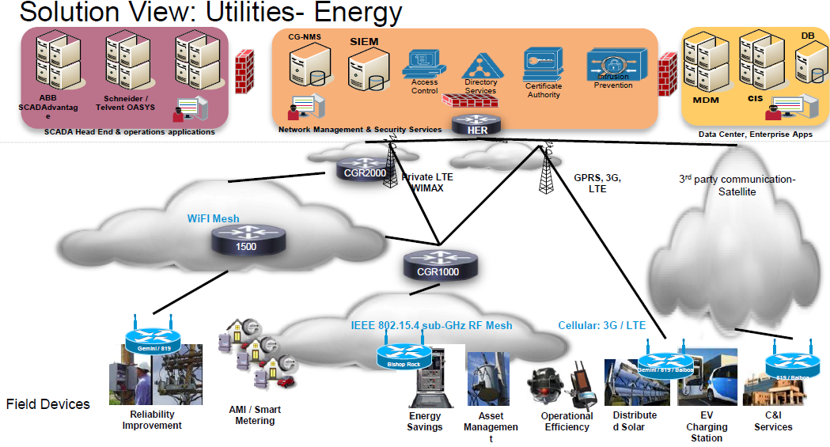

Slide 20
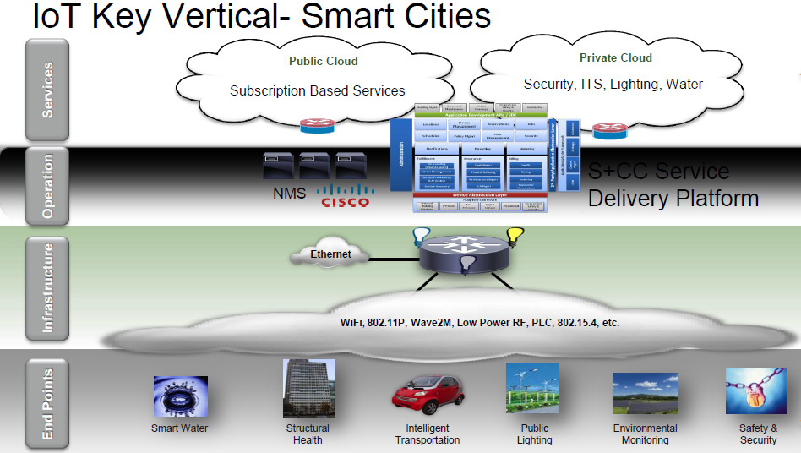
IOT FOR s+CC

Slide 21
Opportunity for Canadian Gov.
Canada can associate with Indian Gov. to adopt a few cities to be developed as Smart Cities ,in a partnership mode with Indian Gov. thru Canadian Industry Consortium and with EXIM Financing support
Canadian Industry Consortium can be from Utility ,IT, Telecom, Software and Control System domains
Large Canadian EPC company with Proven Credentials in Urban Planning, Urban Development and Smart City evolution and Implementation experience can position as a Major Consulting Company and System Integrator
Canadian firms and association's like ICF ,IMEX and thought Leaders like Kristina Verner, John Jung can contribute with an Initiative for sharing the SMARTCITY Implementation plans.

