Slide 1
Innovation in the business world
Two kind of Innovation
Product Innovation; and
Process Innovation
Innovation = Fresh ideas that bring NEW business VALUE (Time, Flexibility, Quality)

Slide 2
Common Definitions:
Innovation is accomplished through more effective products, process, services or ideas that are readily available to markets, governments and society
Innovation differs from invention in that innovation refers to the use of a better and, as a result, novel idea or method, whereas invention refers more directly to the creation of the idea or method itself.
Innovation differs from improvement in that innovation refers to the notion of doing something different rather than doing the same thing better.
http://en.wikipedia.org/wiki/Innovation

Slide 3
Innovation Requirement
The famous robotics engineer Joseph F. Engelberger asserts that innovations require only three things:
A recognized need,
Competent people with relevant technology, and
Financial support
At the same time, Innovation is by its very nature wasteful. It demands experimentation, speculative investment, and failure, all of which entail high costs and risks.

Slide 4
IT Innovation Matters
Nickolas Carr’s 10 years old article “IT Doesn’t Matter” in Harvard Business Review is still affecting business and government leaders
“Old IT” that addresses labor automation, individual worker productivity has limited growth opportunity (e.g. ERP systems)
“New IT” can address the needs of:
Digital Services (e.g. Netflix, Dropbox),
Team collaboration (e.g. Office 365, Google Docs, TelePresence),
Business model Transformation (e.g. Big Data)

Slide 5
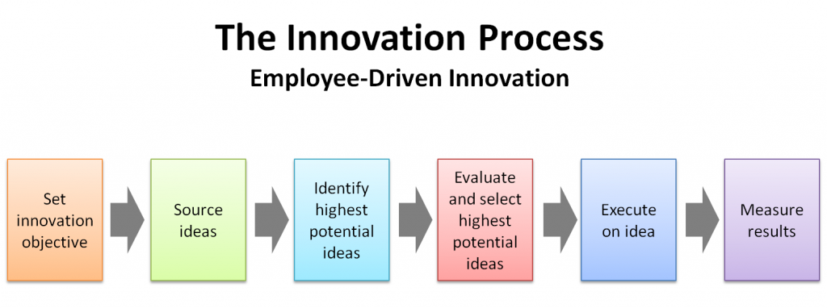
SSC and IT Innovation
Formalize and endorse process to create and adopt internal and external “IT Innovation” projects
For example:

Slide 6
Innovation and Vendor Relationship Management
Investigate and Source
This process has to allow (even encourage) SSC assigned staff to work with IT Manufacturers and their partners (Integrators, resellers, agents) and empower them to identify Innovative solutions and opportunities
Evaluate and Select
Set up Proof of Concepts (POC) projects at the early stage of product cycle to take full advantage of productivity gains and limit risk at the same time (Share cost with vendors)
Execute to Harvest R.O.I.
Ensure existence of “fast & easy” “built-in” method of procurement to quickly adopt and scale from a successful POC to real production projects with support by senior executives. Currently, there is no easy way to transition quickly from POC to production. Creation of Methods of Supply can take 12 to 18 months post POC. The subsequent RFP process can take another 12 to 18 months.

Slide 7
Innovation and Procurement
Procurement has to support and allow prompt response to the process
Traditional RFP process does not allow the quick response to the IT World
Current methods of supply (NMSO, SLSA) are commodity-specific and for mature technology, making them cumbersome to purchase integrated solutions
New process for “Purpose Build” and “Solutions Based” type of solutions has to put in place

Slide 8
Procurement Framework
Call-ups
Elevated
Purpose based
procurement
Solutions
IM/ITComplex
Interoperability Standards / Reference Architecture
Server
Storage
Network
Software
Up to $400K
Up to $1M
Up to $3M
> $5M
Entry Level
Intermediate
Senior
Project Manager
Solution Architect

Slide 9
Solution based procurement
Use Functional and Technical features of the solutions to establish pass/fail BASELINE
Solutions that exceed the BASELINE score extra points for value that translated to better procurement terms (relate value to price)
Allow higher call up limits for high value solutions (reward better solutions)
The process has to encourage ongoing competition as the current model does
Example: Baseline 100 points with maximum 200 points
Solutions | points | single unit price | standard call up limit | discount | maximum call up limit
A | 100-130 | $400K | $600K | 30% | $1M
B | 131-160 | $450K | $800K | 30% | $1.5M
C | 161-200 | $500K | $1M | 30% | $3M

Slide 10
Canadian Innovative Products
Canadian companies can bring their products directly or indirectly to SSC through the same process
Let other Departments such as Industry Canada deal with Science & Innovation Policy
If the Innovative product does not meet the requirement of the process then leave it to PWGSC (CICP Program) to procure new Canadian Innovative products and leave SSC to focus on its own difficult challenges.
No need to duplicate the effort between Departments

Slide 11
Final Words of Advice
Don’t waste taxpayer money on IT Innovation Labs and Processes if you cannot first solve the issue of rapid subsequent procurement of the successful solution(s).
If it continues to take 3 years to establish methods of supply and acquisition of successful POC solutions, then drop the entire investment in Innovation because it’s a bad joke that will demoralize staff and Vendors and is a complete waste of money.
The GoC must realize that in the real world, the reason to invest in Innovation is to capture a measurable Productivity Gain which is EXTREMELY time sensitive.
You must be successful at compressing the Acquisition Timelines to effect any measurable Productivity Gains thereby boosting our relative National Competitive position resulting in an improved standard of living for Canadians.
I suggest integrating the procurement process with the POC process, i.e. don’t bother investing in ANY POCs unless the POC process is integrated with a seamless fast track method of supply, if it is successful.
I suggest that policy should undergo a “TRANSFORMATION” that creates a fast track methodology for Innovative Technologies that have been channeled through a rigorous POC Process!

