Slide 1
Military Procurement – Update
Cathy Sabiston
DG, Defence and Major Projects Sector
Christopher Boyle
Senior Director, Marine Sector

Slide 2
Overview
Management of Major Projects and other defence projects
Major Clients:
  National Defence
  Canadian Commercial Corporation
  Royal Canadian Mounted Police
  Transport Canada
  Canadian Coast Guard
  Canadian Security Intelligence Service
  Communications Security Establishment
  Correctional Services Canada
  Canadian Border Services Agency
  Involvement in initiatives to improve military procurement

Slide 3
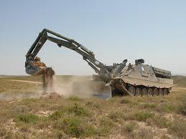

Armoured Vehicles Projects
Force Mobility Enhancement Project
Convert up to 18 Leopard 2 A4 tank chassis into Armoured Engineer Vehicles (AEVs).
Light Armoured Vehicle (LAV) III Upgrade Project Upgrade and improve the protection, mobility and firepower effects of 550 in-service LAV III vehicles
In the last five years :
355 contracts per year
Average annual business value : $1.7B

Slide 4
Aerospace Equipment Directorate
Support contracts for fleet of aircraft (Hercules, Sea King, CF18, Cormorant, Challenger, Aurora and others)
Aircraft and aircraft systems procurement - Civilian and Military
North Warning System
Surveillance, identification, control and warning for the aerospace defence of Canada and the United States.
In the last five years :
1536 contracts per year
Average annual business value : $1B

Slide 5

Electronics, Munitions and Tactical Systems Procurement
Munitions (ammunition and weapons), including laser-guided bombs, torpedoes and rockets
Defence electronics, simulation systems, land tactical command, control and communications systems
Land intelligence, surveillance, target acquisition and reconnaissance systems including radars and UAVs
In the last five years :
1022 contracts per year
Average annual business value : $1.5B

Slide 6
Major Projects - Land
MSVS (Medium Support Vehicle System) Procurement of new medium-sized logistics trucks for the Canadian Forces ($1.58 B)
TAPV (Tactical Armoured Patrol Vehicle) Acquisition of 500 well-protected and mobile, armoured wheeled combat vehicles ($900M)
CCV (Close Combat Vehicle)
Acquisition of 108 new, highly-protected and mobile fleet of armoured fighting vehicles for use in medium to high threat operations. ($3.6B)

Slide 7
Major Projects - Air
Maritime Helicopter Project
Acquisition of 28 fully integrated helicopters CH-148 Cyclone from Sikorsky and In-service support to 2028 ($5.3B)
Medium-to Heavy-Lift Helicopter Project
Acquisition of 15 MHLH aircraft (Chinook
CH-147 “F” model) from Boeing and In-Service
Support (ISS) for 20 years (project value $4.7 B)
Tactical and operational training systems
Procure, and maintain for 20 years, courseware and training devices
for the aircrew operational training capability in support of the CC-130J
and CH-147F fleets ($600M)
Airlift Capability Project - Tactical (ACP-T)
Acquisition of 17 Hercules C-130J from Lockheed Martin and 20-year ISS

Slide 8
Fixed-Wing Search and Rescue Aircraft Replacement
Replacement of current FWSAR aircraft.
The FWSAR project is in Definition Phase
(Development of RFP).
Active engagement with industry
A draft RFP is expected to be released in late summer 2013, with the final RFP to be released in early 2014.
Estimated value: $3.8B for acquisition and In-service Support for period of 20years

Slide 9
CCG Helicopter Replacement
12 to 20 light lift helicopters
4 to 8 medium lift helicopters
2 polar helicopters
Simulators
Project Value: $483 M
Smart Procurement (including industry engagement, governance and third party involvement

Slide 10

North Warning System
Renewal of the North Warning System (NWS) Contract.
Project Value: $930M
Certain % of the firm
contract price must be
for Inuit employment
under the Comprehensive
Land Claim Agreement.

Slide 11
Integrated Soldier System Project
Acquire 6,624 Integrated
Soldier Suites, as well as in-service support and spare parts
Project Value: $490M
RFP is active and
closes 1 Aug. 2013

Slide 12
Marine Sector
Line of business description
The Marine Sector is responsible for the
implementation of the National Shipbuilding Procurement
Strategy and for federal fleet shipbuilding and support
procurement projects.
Number of Employees
79 (in NCR, Halifax & Victoria)
Interface with PWGSC Regional Offices
Major Clients
Department of National Defence, Canadian Coast
Guard
12
Notes:
12

Slide 13
Halifax Class Modernization/ Frigate Life Extension (FELEX)
Mid-life modernization and refit of the 12 HALIFAX Class frigates valued at $2.7B
Two Multi-ship refit contracts with Irving Shipbuilding Inc. and Victoria Shipyards Ltd.
Combat Systems Integrator (CSI) contract with Lockheed Martin Canada
To date a total of six ships are in various stages of their refit and modernization

Slide 14
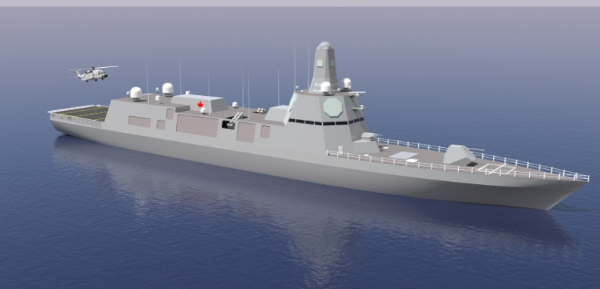
Canadian Surface Combatant
Objective is to acquire up to 15 ships to replace Canada’s existing destroyers and frigates
  Highly complex and challenging requirement (complexity level 4)
Currently in Definition Phase 1 - ship design activities and refine cost estimates/timelines
Industry Engagement is underway and will inform the:
  Procurement Approach for the design of fully integrated combat ships
  Technical Requirement
The Canadian Surface Combatant will be constructed at Irving Shipbuilding Inc., the shipyard selected for the combat package under the NSPS

Slide 15
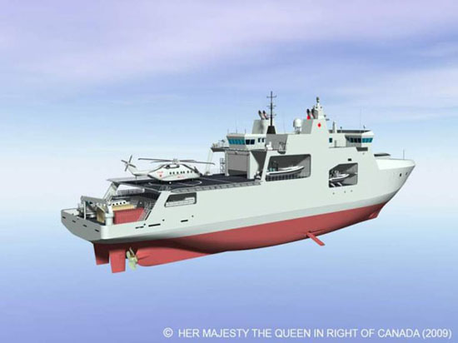
Arctic/Offshore Patrol Ship (AOPS)
First project in Combat Package with Irving
Shipbuilding Inc.
Project to procure 6-8 ships
Definition Contract awarded March 2013
  30 month effort
  Design maturation
  Build preparation
Build Contract planned for Spring/Summer 2015
Ships to be built in new shipyard infrastructure
First delivery in 2018
Last delivery 2023/2024

Slide 16
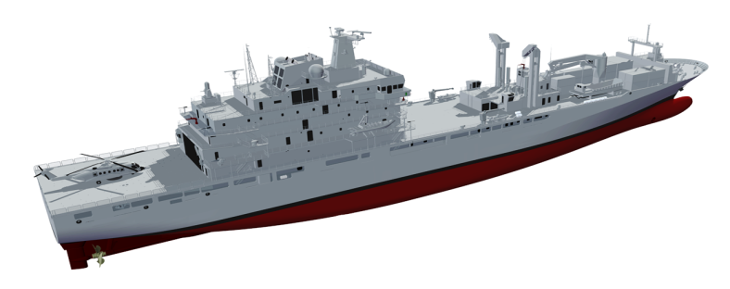
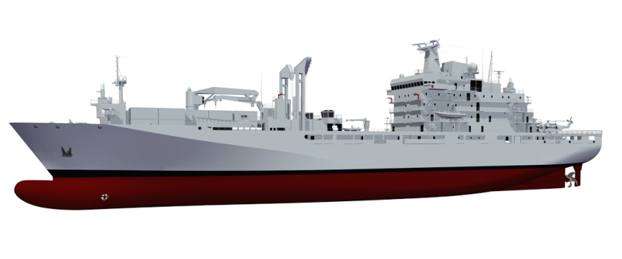
Joint Support Ship (JSS)
Announced in July 2010, to acquire two support ships to replace the Navy’s current Auxiliary Oiler Replenishment vessels, with the option to procure a third with a budget of $2.6 Billion (taxes included)
Part of NSPS Non-Combat package to be built at Vancouver Shipyards Co. Ltd. (Seaspan)
Military Off The Shelf (MOTS) Design selected on June 2, 2013
JSS/Polar Sequencing Decision planned for Fall 2013
JSS MOTS Design
Developer: ThyssenKrupp Marine Systems Canada

Slide 17
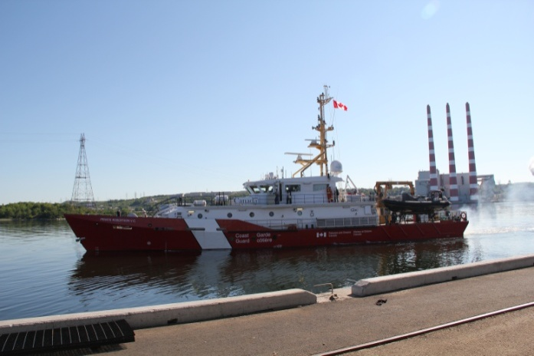
Mid-Shore Patrol Vessel (MSPV)
Competitive Contract for 9 MSPV is issued to Irving Shipbuilding of Halifax, in August 2009, with an option for 3 additional Vessels.
43 metre vessels that will operate up to 120 nautical miles offshore for up to 14 days. Operations will include maritime security and conservation and protection.
Four vessels have been delivered up to now, between July 2012 and May 2013. Three vessels are currently in operation in the Great Lakes Area.
The Five last vessels are currently under construction
Last delivery expected in Fall 2014

Slide 18
Offshore Fisheries Science Vessel
3 OFSV will replace 4 existing vessels and will conduct fishing and acoustic surveys of fish and invertebrates in the Northern Atlantic and Pacific Oceans and monitor changes in marine ecosystems.
Vessels will be 55 metres length overall with the ability to support a complement of 34 persons for 31 days without the need for re-provisioning with food or fuel.
Design completed in January 2012 under a competitively awarded contract with RALion.
Build Contract is part of the Non-Combat Package of NSPS with Vancouver Shipyard Co. Ltd. .
A construction Engineering Contract was awarded to the shipyard in February 2013, to prepare the production drawings
Negotiations for ship-construction contract in process with the shipyard.

Slide 19
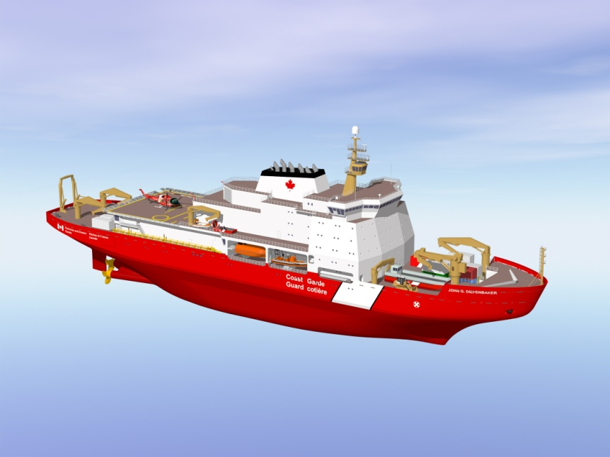
Polar Icebreaker
One Polar Icebreaker was announced in Budget 2008 to become in service as the CCGS Louis St. Laurent, which will be decommissioned in 2017.
The design contract was awarded to STX Canada Marine, Vancouver, BC, on November 17, 2011, following a competitive process.
The Build Contract will be directed to Vancouver Shipyard Co. Ltd. as part of the Non-Combat Package under NSPS.
The design is progressing. Ice Model Testing has been completed in St-John’s
Design contract anticipated to be
completed by December 2013.
Discussions already in process with
Vancouver Shipyard for the construction
Engineering contract.

Slide 20
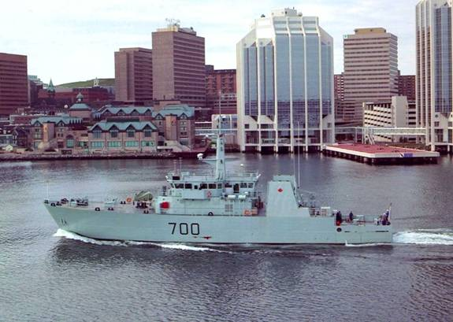
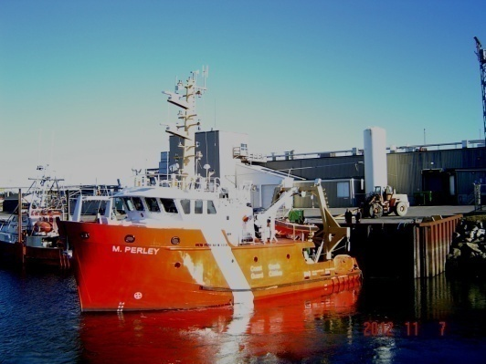

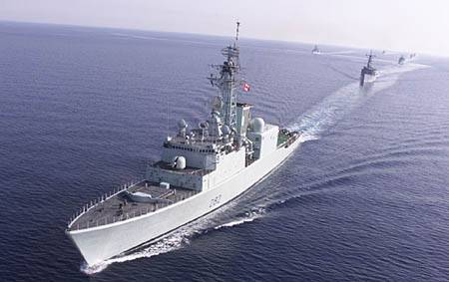
Marine Systems
NSPS under 1000 ton Ship Construction Contracts such as:
Inshore Fisheries Science Vessel
Hovercraft
Fisheries Research Vessel
RCMP Fast Patrol Board
PRV III’s
RHIBS (DND and CCG)
Marine In-Service Support
Marine Logistics
Vessel Engineering
Engine Overhaul
Submarine Rescue
Logistics Procurements
Ship Refits Contracts such as:
Preserver Refit
Protecteur Refit
Athabaskan Refit
Oberon Disposal
20

Slide 21
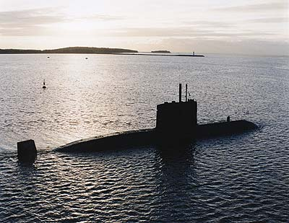
Victoria In-Service Support Contract
        Competitive Contract signed in June 2008 with the Canadian Submarine Maintenance Group now Babcock Canada Inc. to support the four Upholder Class Submarines.
        VISSC received TB approval for $1.7B over 15 years, including 10 option years.
VISSC has successfully established a submarine service capability in Canada
250+ direct jobs have been created with an additional 293 Canadian companies that provide various levels of support to the prime contractor.
HMCS CHICOUTIMI is undergoing the first refit under this contract and is on track for delivery to the Navy in December 2013.

Slide 22
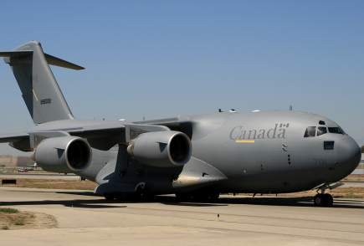
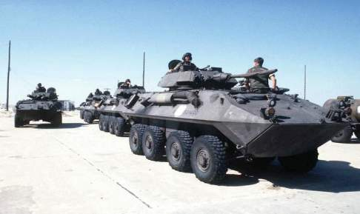
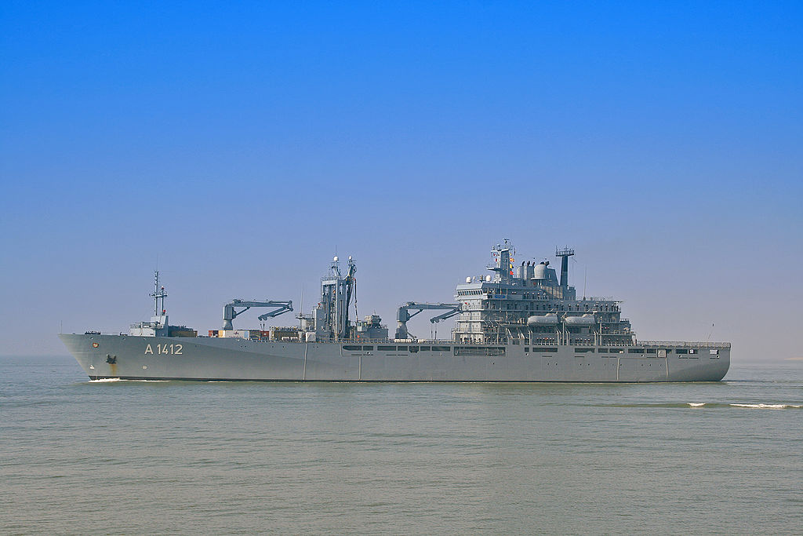
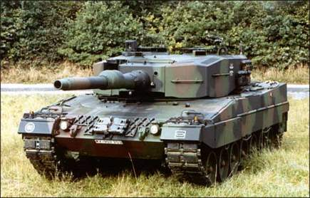

Questions?

